Slide 1
Keyboard Keystroke Audio Prediction Analysis
Basem Saleh
bsaleh2@jhu.edu

Slide 2
Outline
Introduction
Related Work
Approach
Keyboard Recorder Dataset
Dashboard
Data Processing and Experimentation
Results
Conclusion

Slide 3
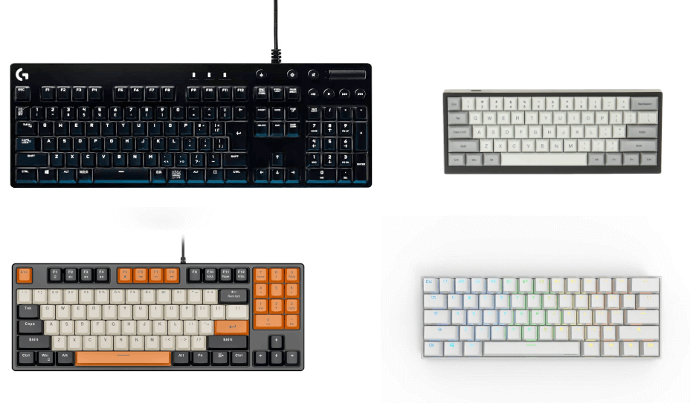
Introduction
Predict Keyboard keystrokes from different types of keyboards(mechanical, scissor).
Recorded keystrokes and processed pulse audio data. Included additional data, like keyboard size.
Created custom fusion model to process audio and additional feature data.
Can successfully predict 1 key with close to 98% accuracy, but cannot classify one key from others.
(Author, Year)

Slide 4
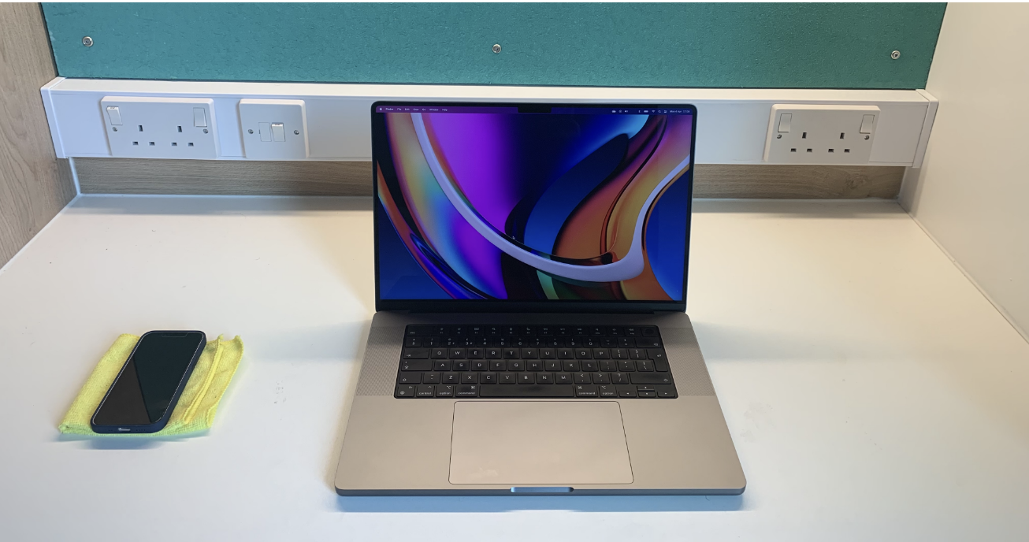
Related Work
A Practical Deep Learning-Based Acoustic Side Channel Attack on Keyboards
Demonstrated 92% accuracy over Zoom and 95% without Zoom in predicting keystrokes from a MacBook Pro using a phone microphone.
SoK: Keylogging Side Channels and Robust Keystroke Transcription
Highlighting the challenges across different keyboards, microphones, and environments.
Different types of switches poses unique challengers since the architecture of each switch is different.

Slide 5
Abstract
Predict Keyboard keystrokes from different types of keyboards(mechanical, scissor).
Recorded keystrokes and processed pulse audio data. Included additional data, like keyboard size.
Created custom fusion model to process audio and additional feature data.
Can successfully predict 1 key with close to 98% accuracy, but cannot classify one key from others.
(Author, Year)

Slide 6
Introduction
Hackers use methods like phishing and key-logging to steal data. Key-loggers record keystrokes and send data in real-time or retrieve it directly.
New Approach: Predict keystrokes using audio from external microphones, avoiding direct access to the computer.
Methodology: Use keystroke audio to predict keystrokes avoiding direct access to the computer.
Project Goal: Test a machine learning model to predict keystrokes from various keyboards (Scissor, linear, tactile) with 80% accuracy or more.
Saleh, 2024

Slide 7
Background
A Practical Deep Learning-Based Acoustic Side Channel Attack on Keyboards
Demonstrated 92% accuracy over Zoom and 95% without Zoom in predicting keystrokes from a MacBook Pro using a phone microphone.
SoK: Keylogging Side Channels and Robust Keystroke Transcription
Highlighting the challenges across different keyboards, microphones, and environments.
Different types of switches poses unique challengers since the architecture of each switch is different.

Slide 8
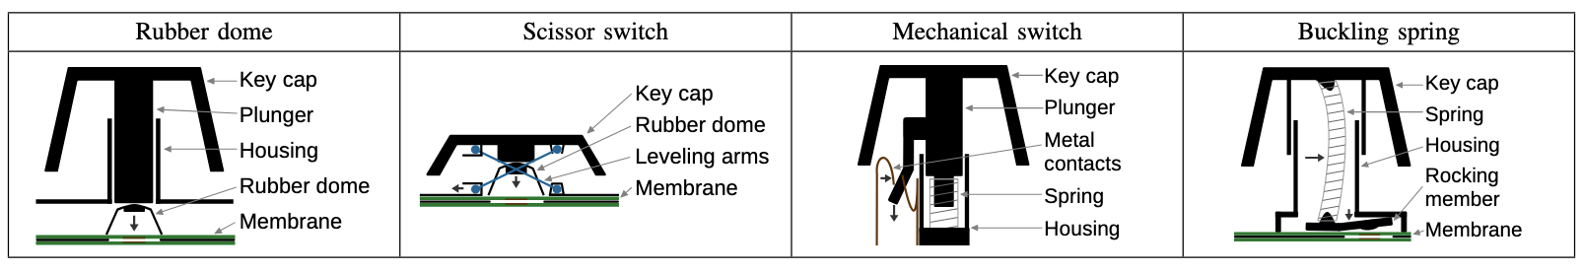

Slide 9
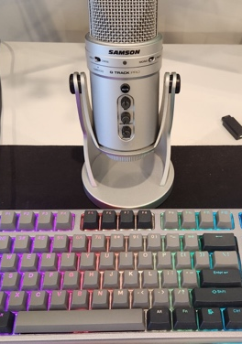
Approach: Keyboard Recorder Dataset
Created a keyboard recorder repository. Includes all data processing as well.
48 total classes
A-Z
0-9
Punctuation on right side
Spacebar
Linear, tactile, and scissor data

Slide 10
Dashboard
https://public.tableau.com/app/profile/basem.saleh/viz/KeyboardDashboard/Dashboard1

Slide 11
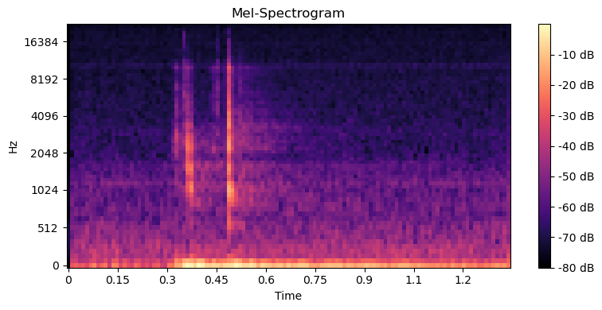
Approach: Data Processing and Experimentation
Audio is placed through mel-spectrogram
Mel coefficients: 64
Window size: 1024
Hop Length: 500
Lower threshold and upper threshold extracts the true pulse from audio files

Slide 12
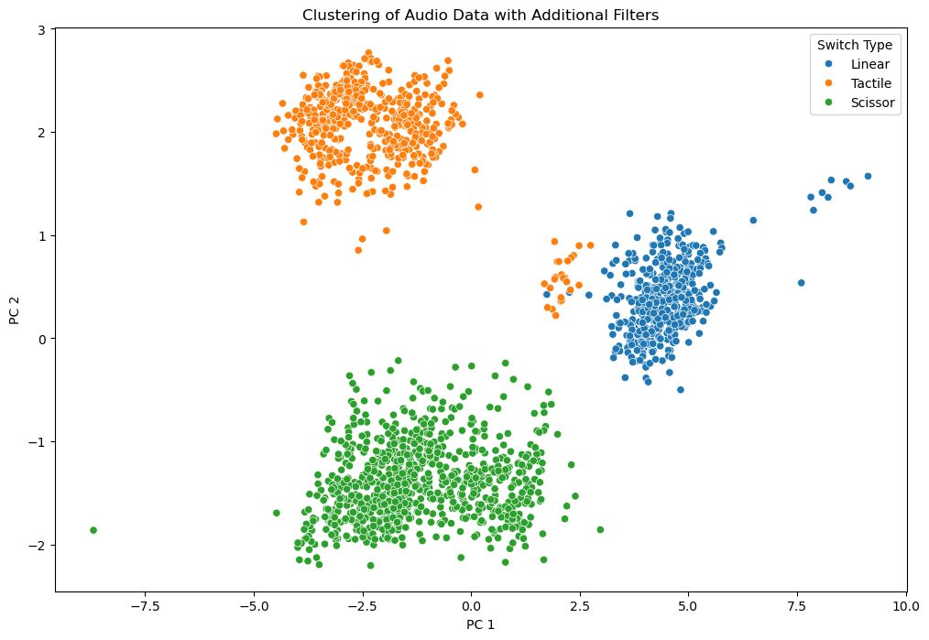
Approach: Data Processing and Experimentation
Analyzed further by breaking down into 13 cepstral coefficients.
Helps extract pulse features and reduce dimensionality
Placed through PCA: generated 2 PCA components
Shows clear separation between the keystrokes
But, is this just captured microphone data?

Slide 13
Approach: Model
Using CoAtNet:
Convolution and Self Attention Neural Network
neural network architecture that combines convolutional layers and transformer encoders, aiming to leverage the strengths of both CNNs and transformers.
Converted into a fusion model that can now process additional data
Uses outputs of Multi-layer Perceptron
Processes keyboard size and key_switch type

Slide 14
Results
Experiments | Classes | Keyboard Recorder Dataset | Accuracy
DeepKeyAttack | 0-9, a-z | MBPWavs | 95.00%
Exp. #1 | 0-9, a-z, punctuation | Full | 23.64%
Exp. #2 | 0-9, a-z, punctuation | Tactile | 1.04%
Exp. #3 | ‘h’ | Full | 98.64%
Exp. #4 | ‘h’ | Tactile | 96.87%
Exp. #5 | ‘space’ | Tactile | 94.79%

Slide 15
Conclusion
The results show that keystrokes can NOT be distinguished between different keyboard switches.
Great for binary classification(‘h’), but not multiclass of all 48 key classes.
Future improvements:
Augmentation should help improve accuracy.
Increase number of recordings.
Keyboards must be recorded under similar microphones and environment. Or, significantly more data across various environments.
Balance between key switch types.

